Slide 1
Digital imaging: objects The Beazley Archive, CLAROS and The World of Ancient Art
Donna Kurtz, Beazley Archive
Sebastian Rahtz, OUCS
Andrew Zisserman, Engineering Science
Notes:
We would like to thank Sue Iversen, Anne Trefethen and David Robey for inviting us.
I will show some of the objects we study and how we use the web to bring them together for users. Sebastian will explain how data about the objects are managed and Andrew will show how the images can change the way users search for information.

Slide 2
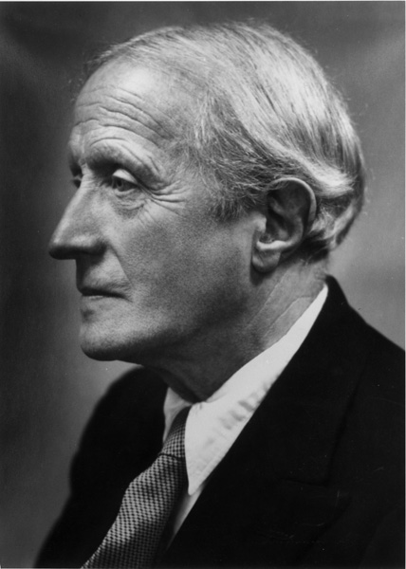
Sir John Beazley
1885-1970
Photograph by Cecil Beaton
Notes:
When Sir John Beazley died in 1970 his photographs, notes, drawings of ancient Greek and Roman art and impressions of classical gems were brought to the Ashmolean Musem. Why?

Slide 3
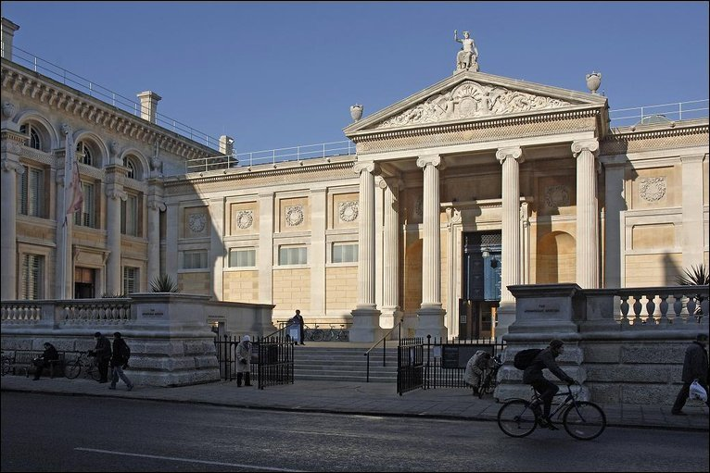
http://news.bbc.co.uk/1/hi/england/oxfordshire/8347232.stm
Notes:
There are several reasons. The university had bought it in 1965 - to thank Sir John and Lady Beazley for the 700 objects they had given to the Ashmolean in 1964.
Since his professorship was by statute also linked to a curatorship of the Cast Gallery the museum was the obvious place. Since the future Beazley Archive would document objects in the museums of the world the Ashmolean was an ideal environment.

Slide 4
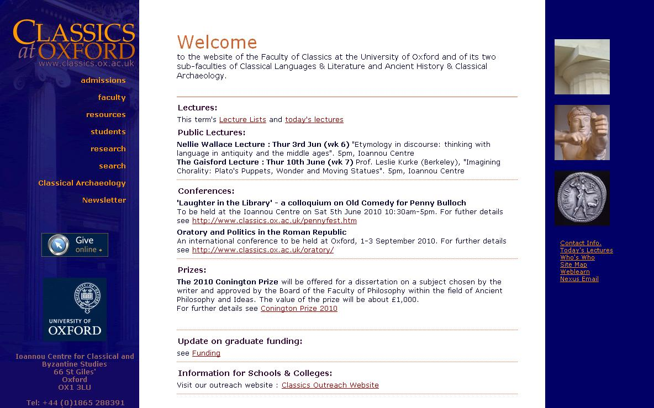
Notes:
In 2007 the Beazley archive was moved from the museum to the Faculty of Classics’ new Ioannou School.
Within the Classics faculty the study of ancient Greek and Latin language and literature has long predominated. Indeed, the study of texts dominates Humanities at Oxford.

Slide 5
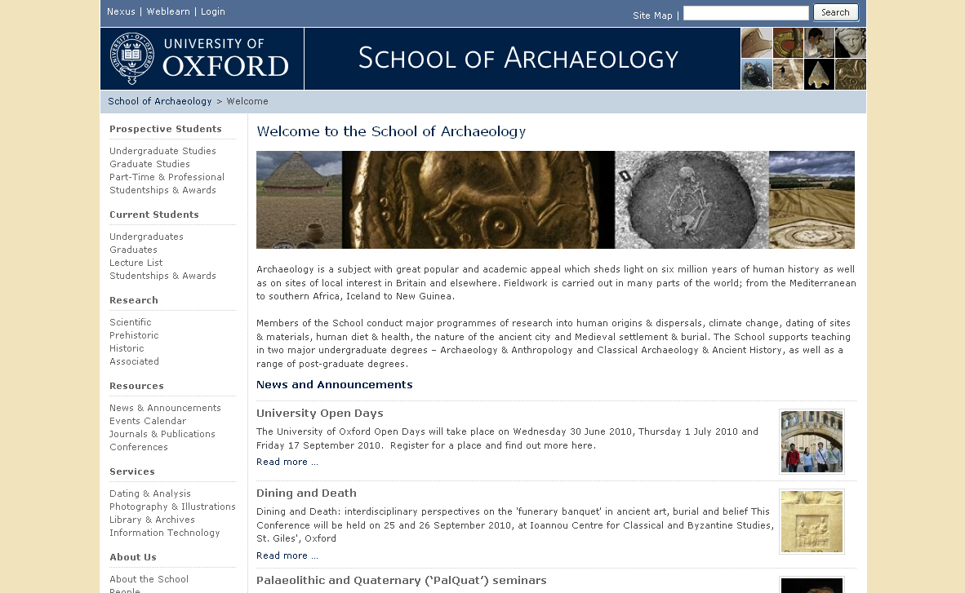
Notes:
Classical archaeology is an object-based discipline that and belongs to two divisions – Classics in Humanities and the School of Archaeology in Social Sciences. We are naturally multi-disciplinary. We benefit from the intellectual rigour of linguistics-based Classics and the science-base of archaeology.

Slide 6
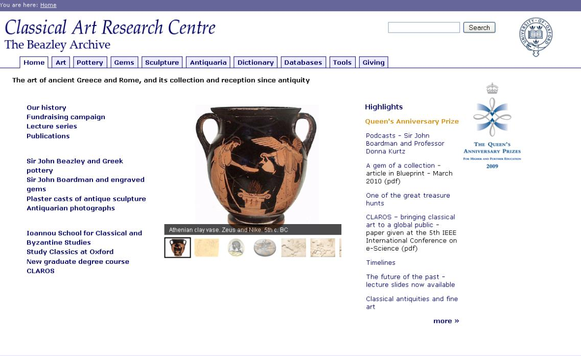
Notes:
The professorship Beazley held was part university teaching and part curatorial work. The post created for me was from the outset part teaching and part curatorial.
This dual role and a solid early background in science probably help to explain why I wanted to transform an old-fashioned paper archive into a research centre for classical art and an international leader in ICT applications in the Humanities.
Today we are actively involved in undergraduate teaching and graduate research. Senior and junior scholars use our paper resources on site and our electronic on line. Our online scholarly databases have 10s of 1000s of users and our web site receives 100s of 1000s hits each day.
While the projects I will show may appear to stand alone, they are all part of a single vision of virtual integration of resources on the web. 15 years ago the web transformed the way we delivered scholarly information.

Slide 7
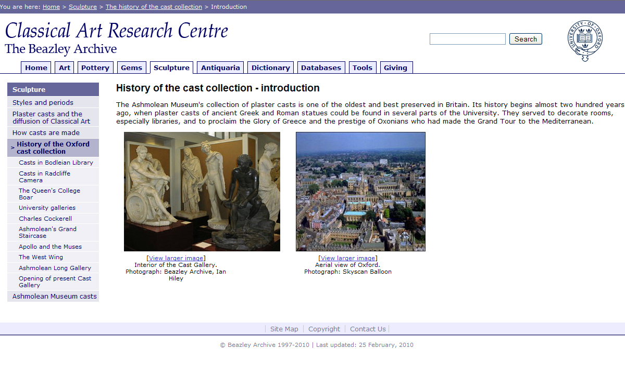
Notes:
The Beazley site has front end programmes built over the past 15 years on an infrastructure of scholarly datasets built by senior scholars over 30 years. The result is a site is for 'everyone' - the broad public, from the child in school to the older adult at home .
That aspect of our work attracted a Queen's Anniversary Prize this year. That one faculty research unit was able to share the honour with the University's six museums and collections is thanks to Sue Iversen who saw that our work complemented the proposal.

Slide 8
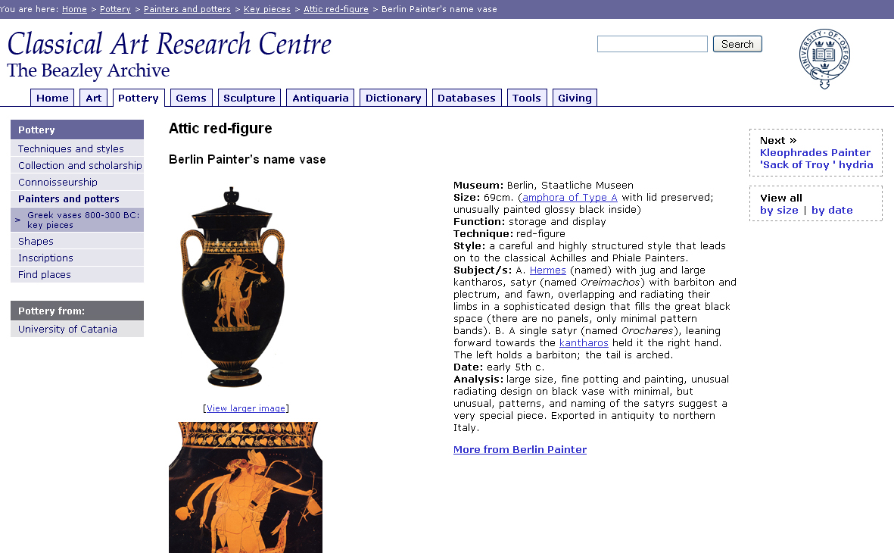
Notes:
The Beazley Archive has more than 5 terabytes of data on classical pottery, sculpture, and engraved gems, antiquarian photographs, archaeological sites and geocoordinates – all in highly structured datasets.
The pottery database that began in 1979 has more than 150,000 objects and 130,000 images.
You see it here in its user-friendly format. There is also a very scary XML version for advanced searching.
When Beazley assigned about 180,000 vases to about 1000 individual painters he was creating a classification system so rigorous that Lou Burnard and Susan Hockey were able to create fields for electronic documentation easily in 1979. Since 1979 we have worked closely with OUCS.

Slide 9
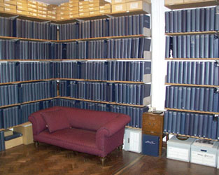
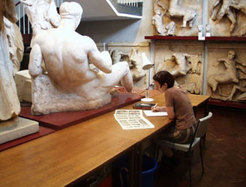
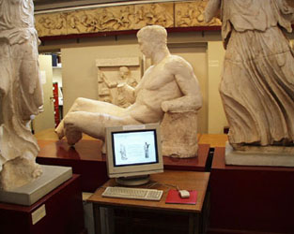
Ashmolean Museum, Cast Gallery basement
Notes:
Pottery gave us the experience to create more databases for other types of material, for example, the plaster casts that surrounded us in the Cast Gallery.
That programme was made for the visitor to the gallery. We regularly asked visitors how they thought it could be improved.

Slide 10
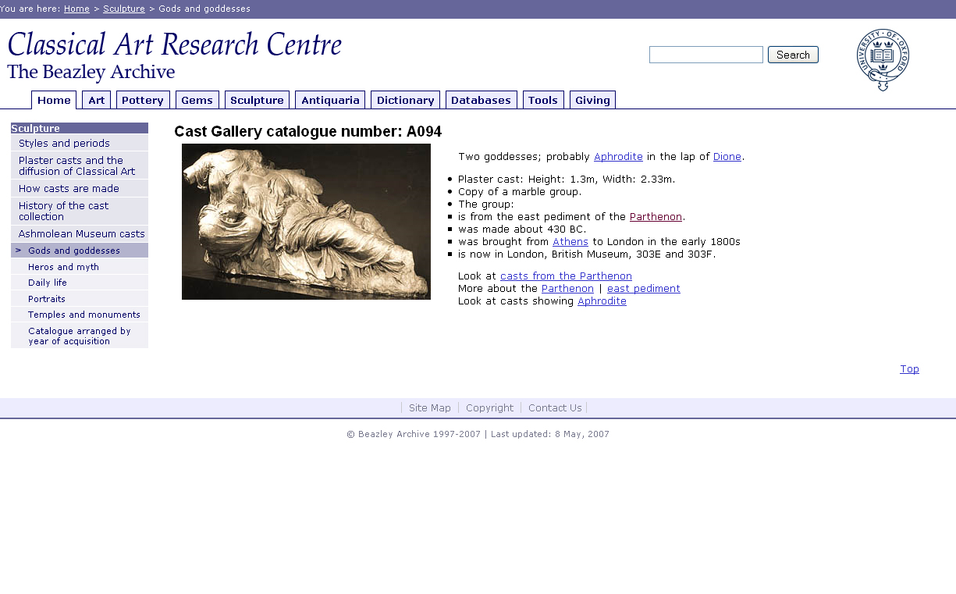
Notes:
This record is for sculpture from the Parthenon. The information is very basic and hyperlinks to an illustrated dictionary make the subject accessible to a broad public

Slide 11
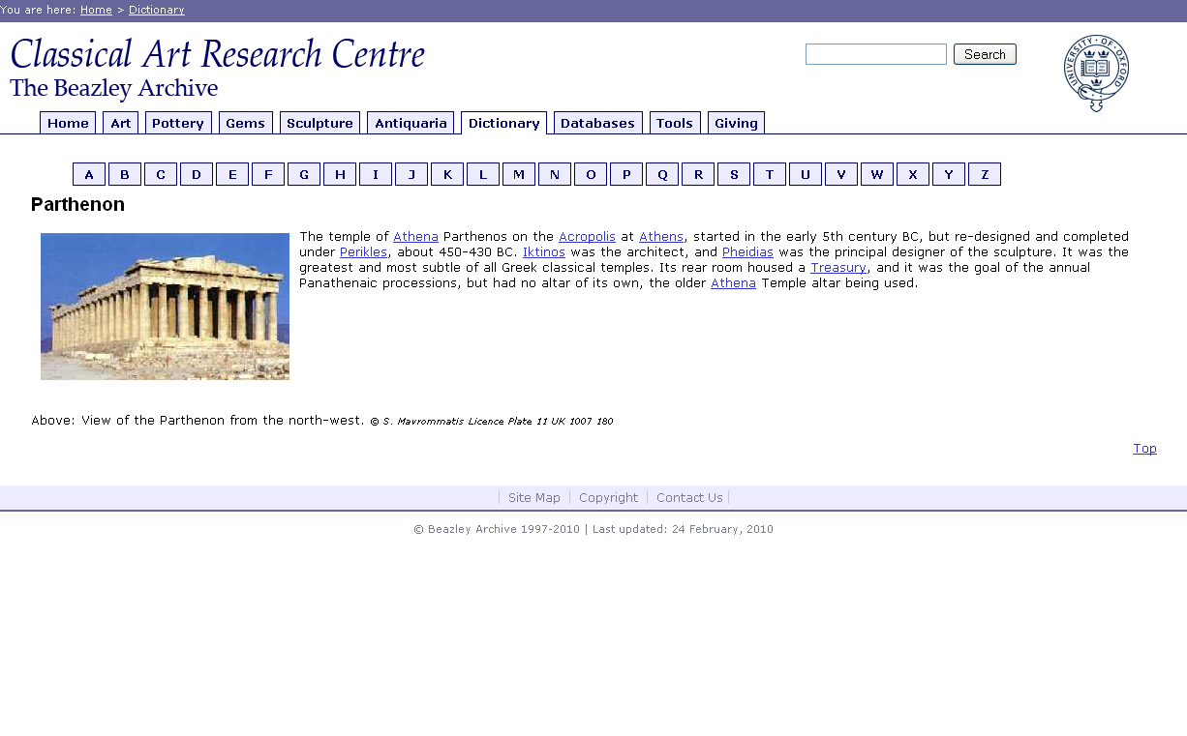
Notes:
The Dictionary has many hyperlinks, here to the Parthenon

Slide 12
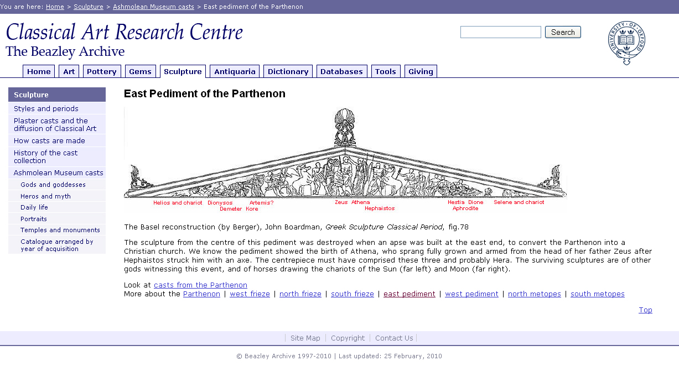
Notes:
And here to its sculpture – the group with which we began.

Slide 13
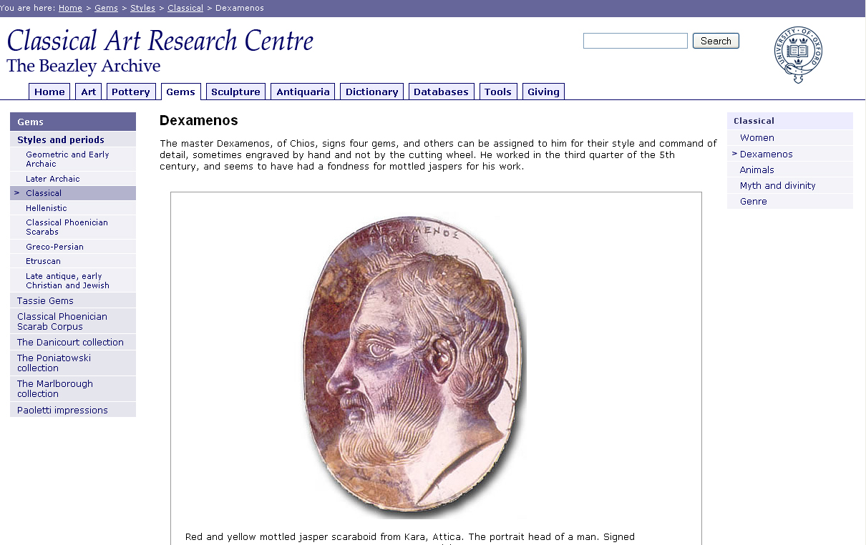
Notes:
Since Beazley also had 10s of 1000s of impressions from engraved classical gems, we created a database for them too. We now have about 50,000 gem records and images.
This portrait was engraved and signed (point out) by Dexamenos who lived around the time the Parthenon was built. That reminds us that these different types of objects belong to the same culture. More than 10 years ago we realised that we needed to enable users to search across them.
While the web had given us a platform for delivery of information from the mid-90s, the emergence of semantic web technologies over the past 5 years have focused our attention on interoperability – delivering to the user an integrated packet of information suited to his needs.

Slide 14
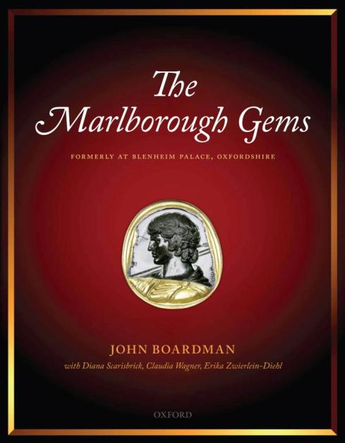
Notes:
Just as a plaster cast is an exact copy of marble or bronze sculpture, an impression is an exact copy of an ancient gem.
Sir John Boardman used the Archive’s complete set of the nearly 800 gems once in Blenheim Palace to reconstruct the Marlborough collection which was sold at auction in 1899. The OUP published his book and we put the material on the web to enable scholars and collectors to continue the process of identifying dispersed originals. Engagement with the public has also become a focus of our ICT research.

Slide 15
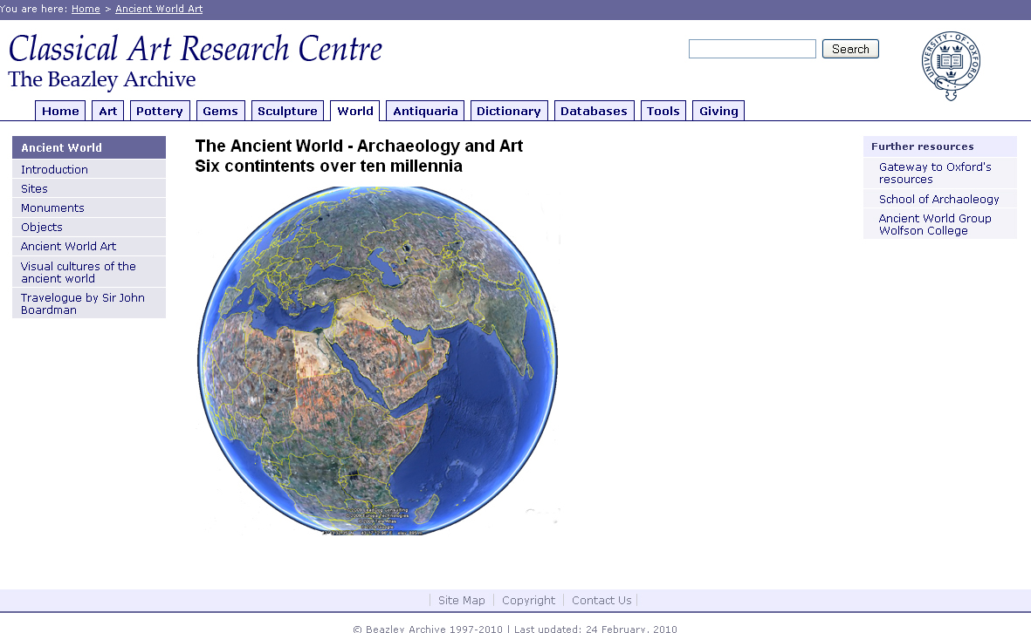
Notes:
When Sir John published The World of Ancient Art in 2006 he encouraged me to offer a graduate course on world art.
I will offer it from the autumn, but it will have been designed for the web, not for the traditional tutorial. It will make extensive use of web resources and I hope it will serve as an interdisciplinary collaborative platform with the School of Archaeology for scholars in Oxford and around the world. When I saw highly professional accounts of recent excavations in Pakistan being posted to Facebook I was convinced there was a need for such a platform.

Slide 16
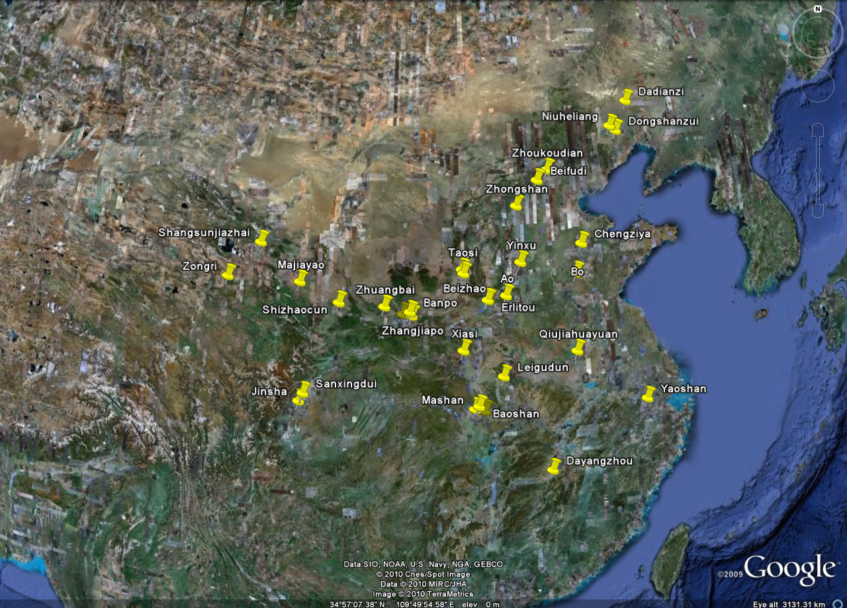
Notes:
We want to show the power of the web to advance scholarship and we want to push the technology to serve our needs.
We have, for example, already plotted sites on to Google Earth – here for ancient China. Unlike traditional scholarly publications which use schematic maps and different names we want to trawl the web for precise details of location and archaeological discoveries. We want to use Google Earth for virtual tours that can stop at a site, zoom in, even to specific graves to view specific objects. We then want to go to the museum where the object is displayed and make its cataloguing information available. And we would like to make apps for the iphone.
As part of our commitment to showing the power of the web to engage the public to advance knowledge we will use social networking sites such as Facebook, Flickr and You Tube. They offer a huge number of images of archaeological sites and objects.

Slide 17
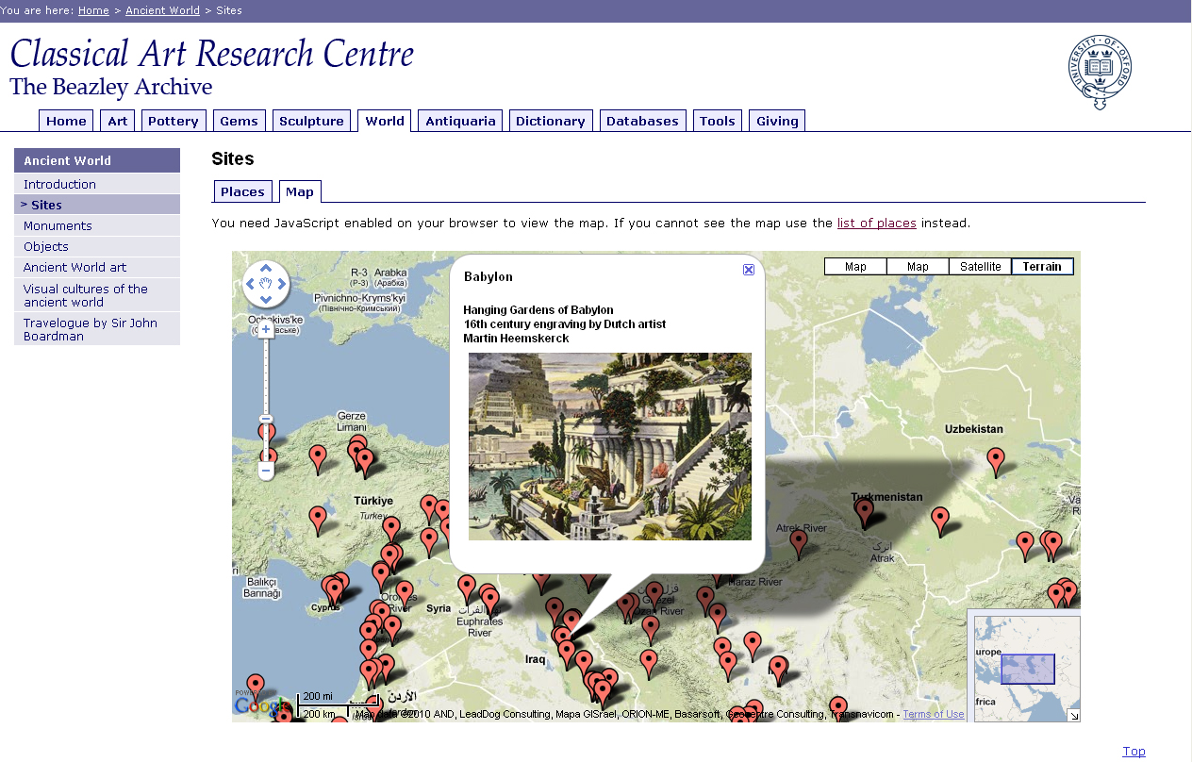
Notes:
When we plot archaeological sites on to Google Maps we can add links to web resources, for example, here to Babylon in Iraq and its Hanging Gardens.
We are also integrating virtually the many thousands of sites recorded in Beazley datasets with the many thousands more in the databases of our CLAROS colleagues. Sebastian will be talking more about this.

Slide 18
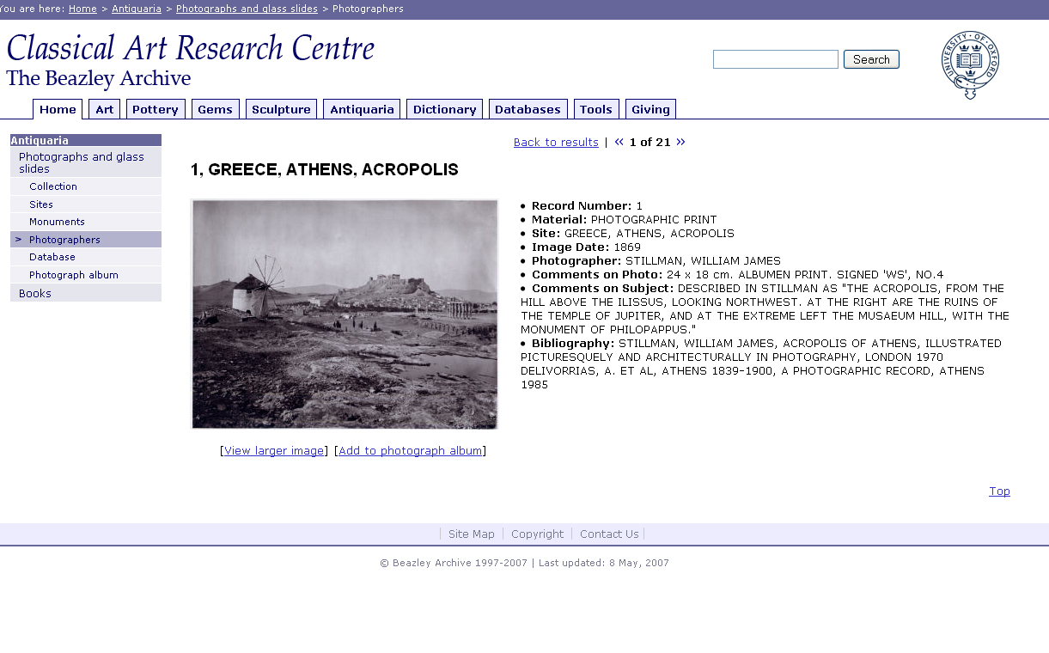
Notes:
Antiquarian photographs can help us to follow their history. The Archive has about 2000 of archaeological sites in Mediterranean countries dating from 1859.
This slide shows the user-friendly format not the scary xml that will enable us to link these antiquarian photographs to recent colour photographs of sites in The World of Ancient Art – and to those of our colleagues.

Slide 19
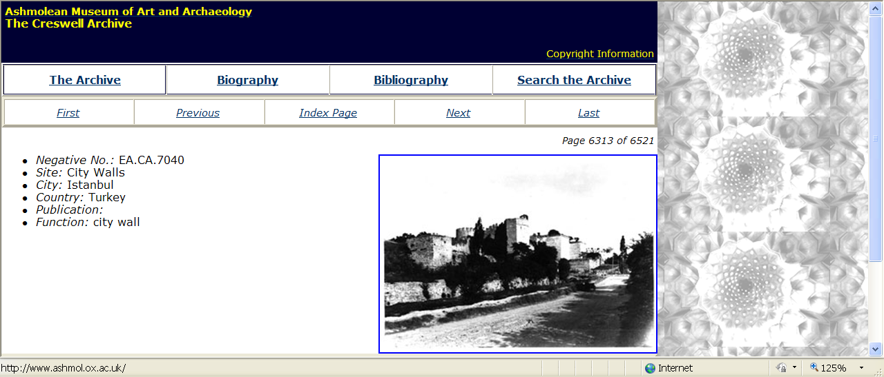
Notes:
The OeRC is supporting a project to bring together the university's huge collection of ant phots on the web. They are in libraries, institutes, faculties, museums and colleges. We are beginning with the Creswell Archive in the Ashmolean Museum which has nearly 7000 photographs of Islamic architecture.
To bring the notional 100s of 1000s of these photographs in the university together virtually on the web we will use technologies we have been developing for CLAROS - Classical Art Research Online Services.

Slide 20
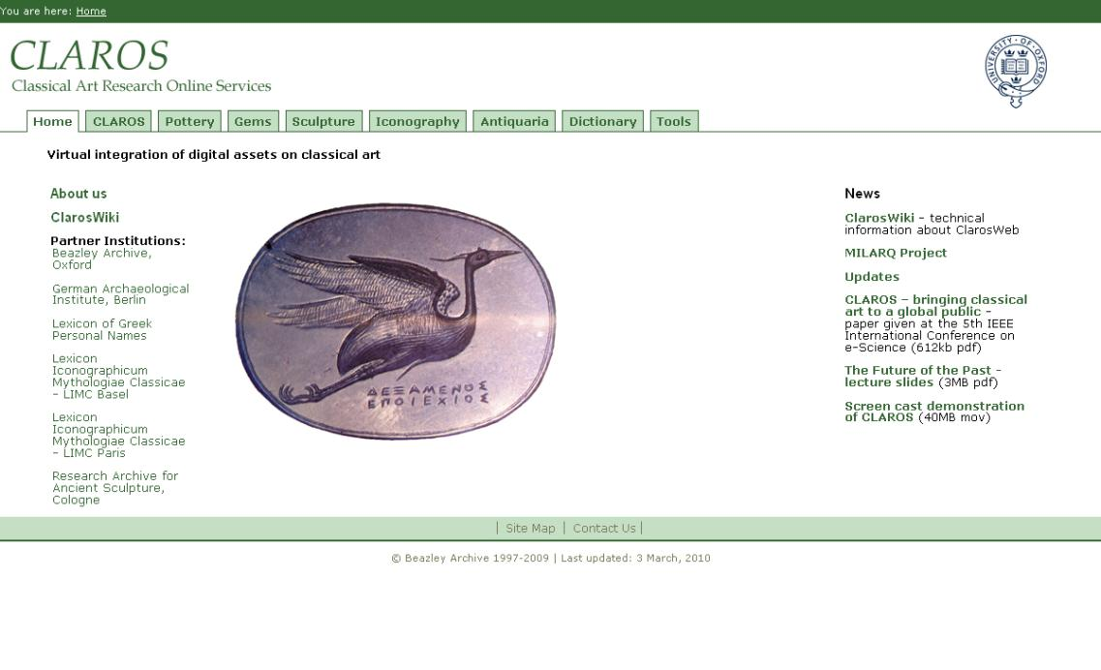
Notes:
From the outset the CLAROS group was envisaged as an international collaboration with major European research institutes that do what the Beazley Archive does - document ancient Greek and Roman Art held in the museums of the world. This founding member group has more than 25 terabytes of data.
Looking at the list on the left you will also see a non-art resource, LGPN. Our art comes from a literate society, names recorded by LGON appear on art objects. LGPN also links us technically to the highly developed epidoc community of digital scholarship. And that highlights CLAROS’ commitment to collaborative research in art and ICT.
CLAROS is a technical research collaboration between Art and Science. Classical art is used as a model for other types of material – for example the World of Ancient Art.
You may wonder why we did not start this collaboration with museums?
For a variety of reasons museums are less easy to work with than research centres in universities. Until recently only museums in universities had high speed networks. Few museums have had the funds to create illustrated electronic catalogues and even those that have created them have had limited success sharing data with other museums

Slide 21
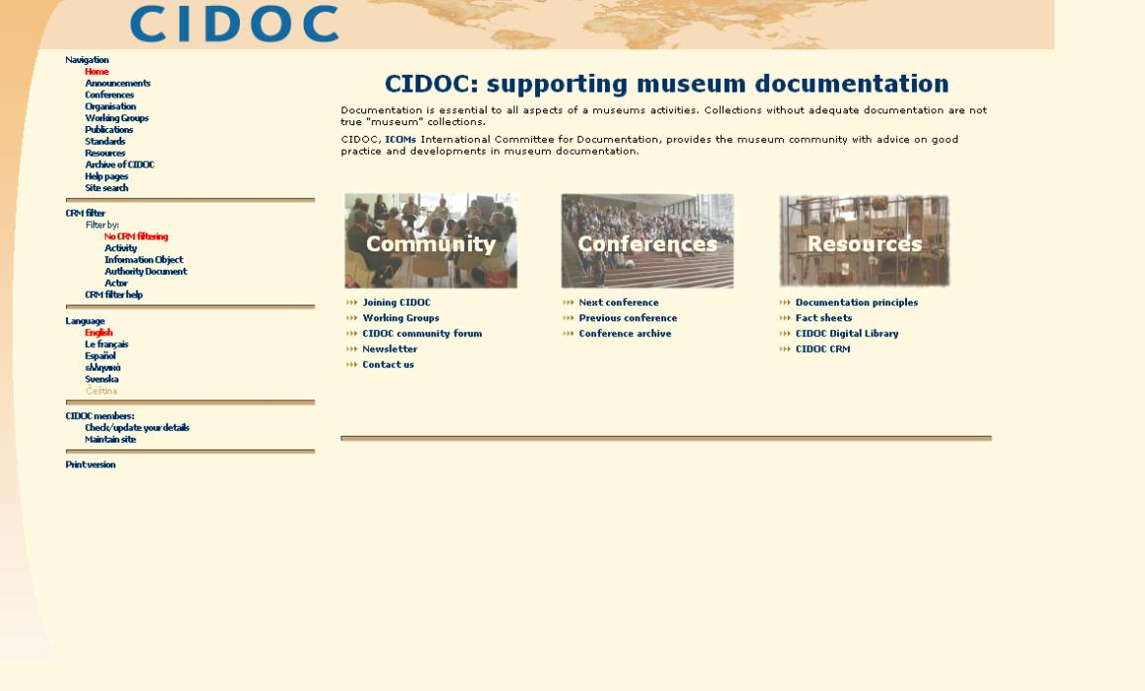
Notes:
From the mid 90s UNESCO realised that the museums of the world, with many different types of objects, would benefit from collaboration. They commissioned the development of an ICT system for the International Council of Museums. This is the system – CIDOC – that we have adopted for CLAROS.
From January, thanks to a grant from the Onassis Foundation, we will have a CLAROS post in Greece to work with museum curators and excavators.
I am also we may be able to work with China under the auspices of the Union Academique Internationale and the Chinese Academy. China has the archaeology, the technology and a national programme of electronic cataloguing.

Slide 22
CLAROS System Components
Beazley Archive
DAI Arachne
LIMC (Paris)
LGPN (Oxford)
Convert
Convert
Convert
Convert
CIDOC-CRM data
Cache
Links back to original data
Index
Query
Other potential applications
CLAROS application
Browser
Notes:
22
How does it all work? Sebastian will explain how we were able to integrate virtually more than 2,000,000 records and images during 2008/9 in a project funded by Fell and supported by OeRC.

Slide 23
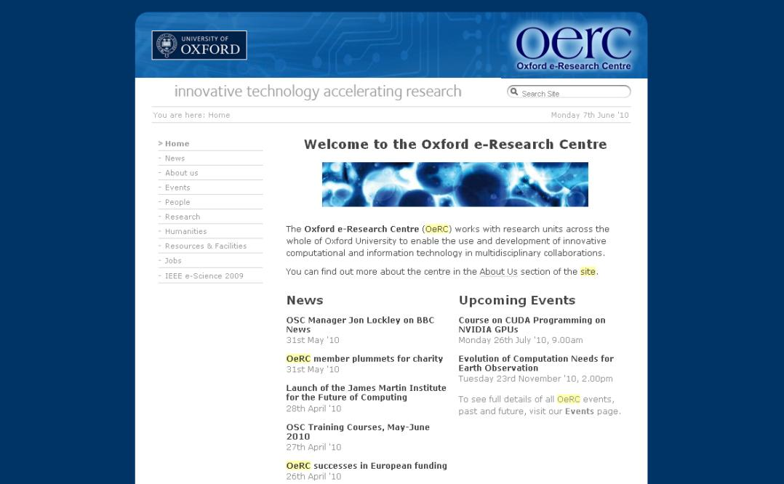
Notes:
OeRC has enabled us to build a team that is a genuine partnership between Art and Science. Anne Trefethen Paul Jeffreys attend our meetings once a term. To both we owe many thanks.
I would like to give just two examples of how this collaboration has developed.

Slide 24
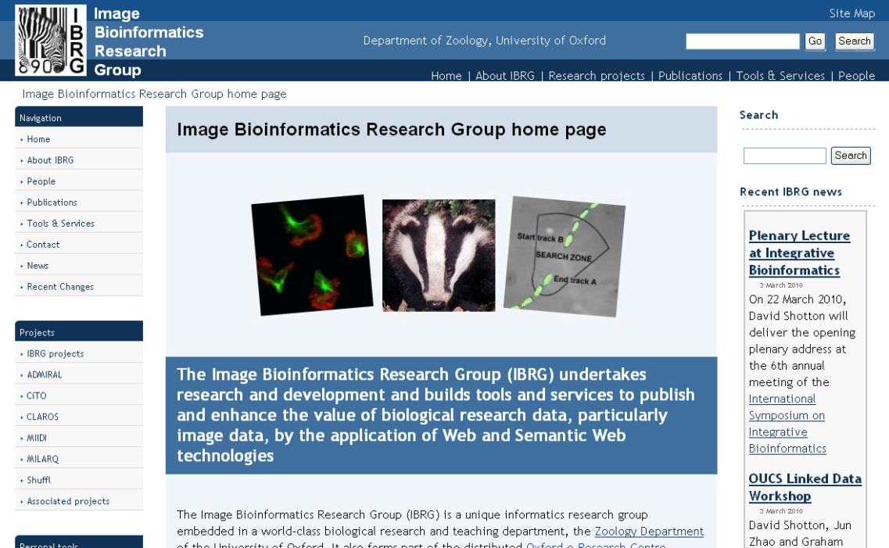
Notes:
David Shotton leads the Bioinformatics Research Group in the Department of Zoology. He is a leader in emerging semantic web technologies. He is also a fellow of my college.
We had seen each other for decades, but it was OeRC that brought us together three years ago. We quickly realised that classical art and fruit flies, badgers and zebra, benefit from the same technology.

Slide 25
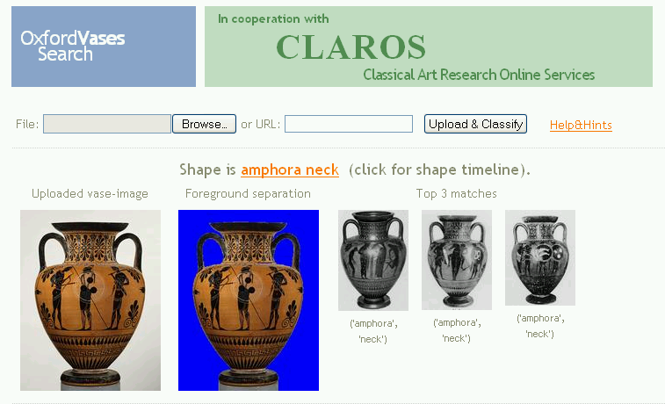
Notes:
And when I attended a lecture by Andrew Zisserman a few years ago I was greatly impressed by the image recognition work but puzzled by his use of old films. When he said he needed images for his research I offered him about 130,000 of Greek pottery and he created this image recognition search that can find a vase in a fraction of a second.

Slide 26
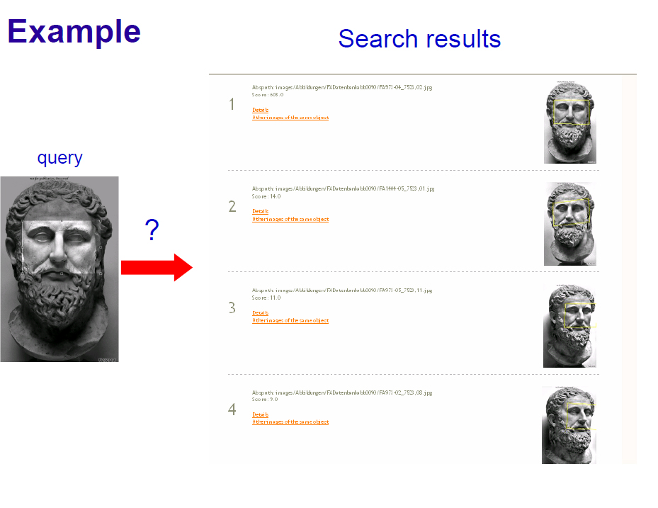
Notes:
The results were so impressive that our CLAROS colleague in Cologne offered him 500,000 of classical sculpture. Andrew will be explaining this work.

Slide 27
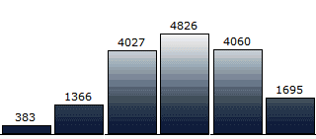
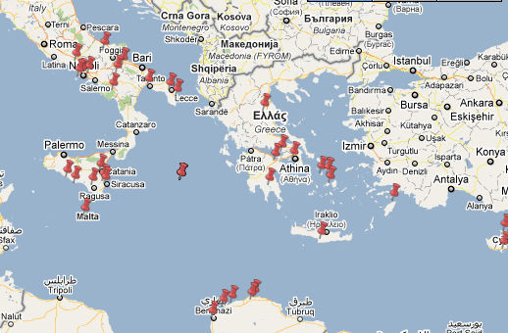
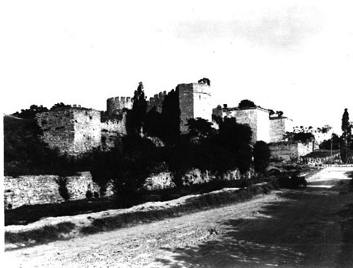
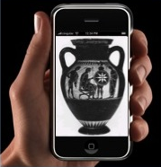
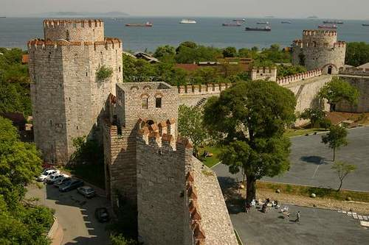
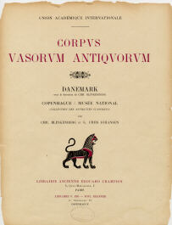
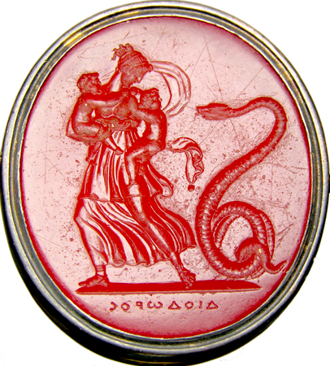
Notes:
old and new walls of Instanbul, page of CVA, map of distribution of Jews etc

Slide 28
The place of images
representation of real-world objects | pottery, gems, sculpture
objects as holders of textual sources | images of inscriptions and coins
representations of time and place | chronological mapping
input and interaction | “what is this pottery shape I am showing you?”
first class objects | antiquarian photographs
visualization | charts, plots, etc
Notes:
this is not all textual data – images play a big part in the work of CLAROS, as first class objects, as data input, as visualization output, and as a record of data

Slide 29
Behind CLAROS
The CLAROS infrastructure relies upon a set of technology standards:
a common ontology − CIDOC CRM conceptual reference model
a common approach to data management − RDF
working practices:
federation not aggregation − devolved responsibility
collaboration − more than Oxford
proportionality and subsidiarity − no attempt at a universal model
open data − we are not the only users
and assumptions:
open licensing − no data hoarding
no limits − world wide
a range of impact models − not limited to academia
Notes:
summary of the universal approach which the CLAROS project adopts, stressing openness, low cost, collaboration, and broad scope, and general technical specs

Slide 30
CLAROS initial collaborators
Beazley Archive:
150,000 Pottery records and 130,000 images
50,000 Engraved gem and cameo records and 30,000 images
900 cast records of classical sculpture and 2000 images
900 Antiquarian photographs
Lexicon of Greek Personal Names:
400,000 recorded individuals. Over 35,000 unique personal names from 2500 places
Cologne Research Sculpture Archive
250,000 Sculpture records, 490,000 images
German Archaeological Institute:
1,500,000 photographs
Lexicon Iconographicum Mythologiae Classicae (Paris):
100,000 records, 180,000 images of mythological and religious iconography from 2,000 museums and collection
Notes:
Summarizing the type and scale of data in our initial experiment. we have to make this work before we join up with more data partners, but we believe this is representative data. we expect to work next with the Economy of the Roman Empire in Oxford, and expect to be able to look at, for instance, data about shipwrecks across a wide range of data

Slide 31
Disparate technologies
Beazley Archive
‘XDB’ – XML data, SQL Server Database, ASP front end
Cologne Research Archive and German Archaeological Institute
‘Arachne’ - MySQL database, PHP front end.
LIMC
MySQL database, PHP front end.
LGPN
Ingres relational database, also available as an eXist XML database serving TEI-XML data. XQuery front end.
Notes:
We do not all start off with the same database technology, let alone the same schema

Slide 32
The CLAROS data web approach
No changes to the databases of the individual sources
Semantic differences between data sources are resolved by mapping selected metadata from each source to CIDOC-CRM
Syntactic differences between data sources are resolved by converting the selected metadata to RDF, accessed from a single triple store using SPARQL
CLAROS is a resource discovery service − all results link back to host databases
The job of CLAROS is provide cacheing, indexing and querying services
Notes:
Our approach is not data collection and aggregation, but providing resource discovery. we only pull data from hosts that which can be linked semantically

Slide 33
CIDOC Conceptual Reference Model (CRM)
Notes:
CIDOC CRM is a conceptual reference model developed over the last 15 years by CIDOC, the International Council of Museums Committee for Documentation, and published as ISO standard 21127 in 2006.
It tries to describe, in essence, events and objects, and places. These are subclassed into smaller and small specializations - this slide only shows one level of detail. the 84 distinct entities are enhanced by 141 possible relationships between them

Slide 34
CIDOC CRM in CLAROS
CIDOC CRM Core can describe the complex provenance of artefacts and their relationships with key events, people, places and times
The CIDOC CRM "E55.Type" system is particularly useful to permit faceted/drill-down queries, e.g. restricting results by the shape of a pot
We focused initially on the CIDOC CRM Core terms, and employed additional terms as necessary. Some additional RDF vocabulary for time metadata relating to imprecise periods and eras i.e. <claros:not_before> and <claros:not_after>, applied to a <crm:E61.Time_Primitive object>
Notes:
we use a subset of CIDOC, and put a lot of emphasis on its type system for classification of objects. This is an area which will be revisited in the coming year, looking at other represenattions of typologies. We have had to make few extensions to CLAROS so far, initially in order to model imprecise time

Slide 35
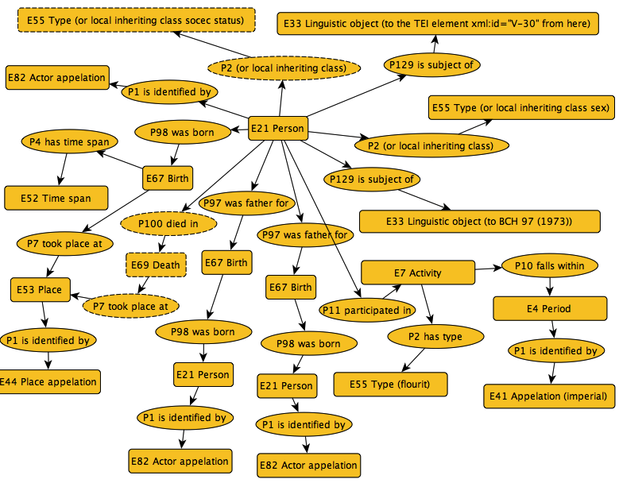
Notes:
This is an example of one part of the mapping in CIDOC CRM. It shows how a piece of data about a person, their relationships, names, and life events is managed by a set of relationships between object type. Although it looks threatening at first sight, the method is consistent and powerful

Slide 36
The CIDOC route to 2nd century BC Athenian amphorae
E22.Man-Made_Object
P2.has_type
E55.Type
P127.has_broader_term "Amphora"
P108I.was_produced_by
E12.Production
P4.has_time-span
E52.Time-Span
P82.at_some_time_within
E61.Time_Primitive ;
not_before "-0300"
not_after "-0200"
P16I.was_used_for
E7.Activity
P2.has_type "Object"
P7.took_place_at
E53.Place
P87.is_identified_by
E48.Place_Name "Athens"

Slide 37
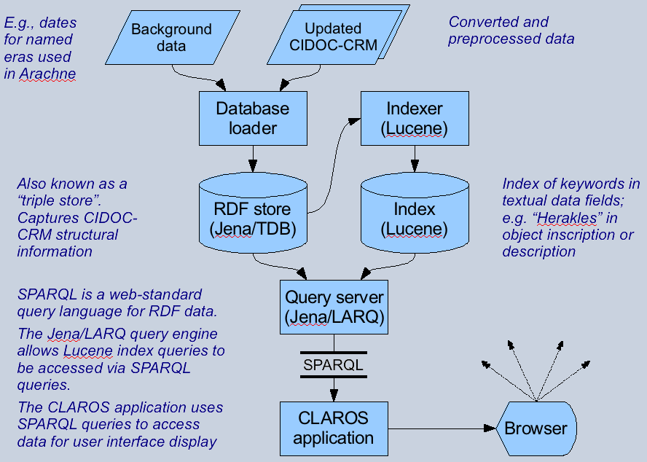
Notes:
this diagram shows the complete workflow, whereby the data is loaded from the sources into the CIDOC-aware triple store, indexed, and served up using SPARQL. Much of the seaching is textual, so the Lucene index plays a big part

Slide 38
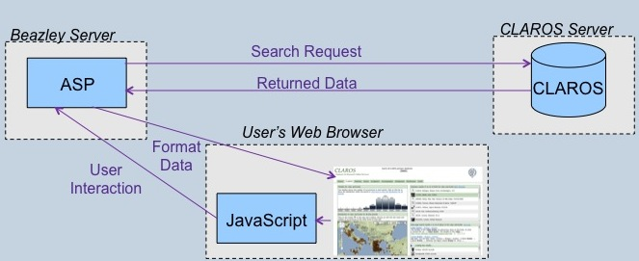
Each data partner may create their own interface, e.g.:
Notes:
Exposing the SPARQL endpoint allows a programmer to write an interface. The Beazley archive demonstrates this, using ASP to query the CLAROS database and Javascript to provide the user facetted browser experience

Slide 39
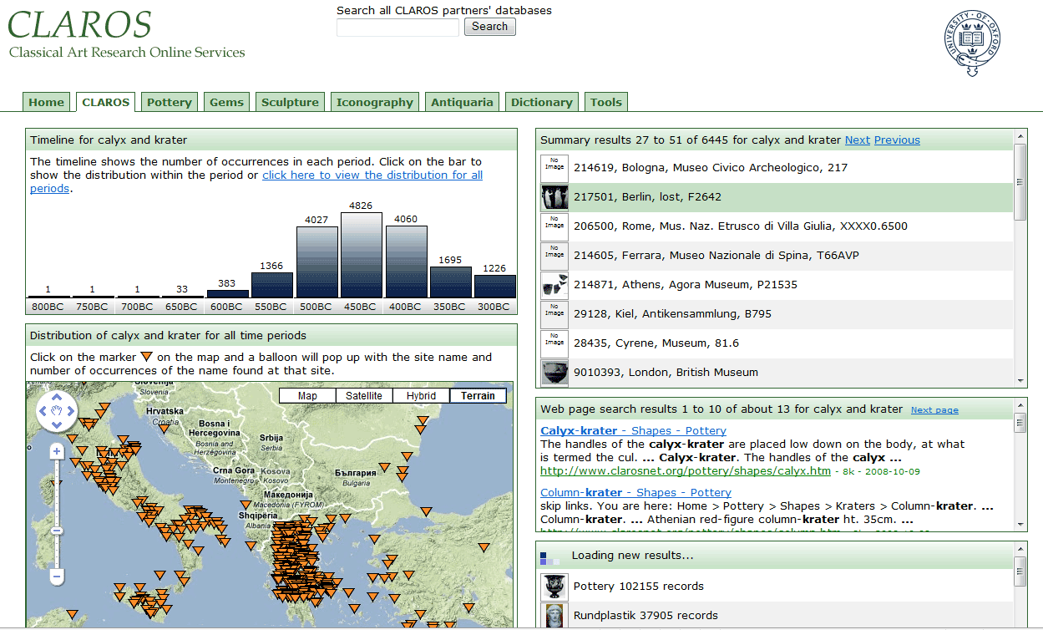
Notes:
the exemplar interface. as data changes in one panel, so the others reflect it

Slide 40
Some ongoing partner projects
MILARQ (Oxford)
investigate performance issues with complex queries in RDF
Metamorphoses (Oxford)
establish a working co-reference system for name, place and date information
develop and document import for into the CLAROS RDF database
provide web-based tools for geo-temporal cross-searching and visualization of the database
STAR/Stellar (Glamorgan)
extraction of semantic data from unstructured text (archaeological report)
Zoology (Oxford)
flyweb, semantic web, and text mining projects
Oxford Roman Economy project
adding new types of economic data
Notes:
we have data partmers, but we also have our technology partners

Slide 41
Lessons
We are in a very different state from 10 years ago, with
mapping and satellite services from Google and others
semantic web technologies which deliver on their promise
Web 2.0 approaches which let us write exciting interfaces
an increasing assumption of free access to data
an expectation of data for computers, not just humans
CLAROS is an exemplar virtuous virtual collaboration with no centre and no boundaries, a club anyone can join
We demonstrate that the RDF approach based on a wide-ranging ontology is not exotic, constraining or hard to use

Slide 42
Challenges
Deliver a system in which searching for “Athens” does not take 5 minutes to respond (there are a lot of references to Athens…)
Join data relating to places in a more formal way
linking via a common gazetteer
modelling changes of name and location across time
understanding degrees of accuracy in provenance claims
Establish appropriate interfaces across the spectrum
SPARQL endpoint for deep access
RESTful URIs for common data queries
Explorer-style data exploration
Dynamic data-driven visualizations for teaching
Intelligent Companions to formulate queries
Rich mobile-delivered resources for museum visitors
Linked community-led collections

Slide 43

Visual Access to Classical Art Archives within CLAROS
Relja Arandjelović and Andrew Zisserman
Department of Engineering Science
University of Oxford

Slide 44
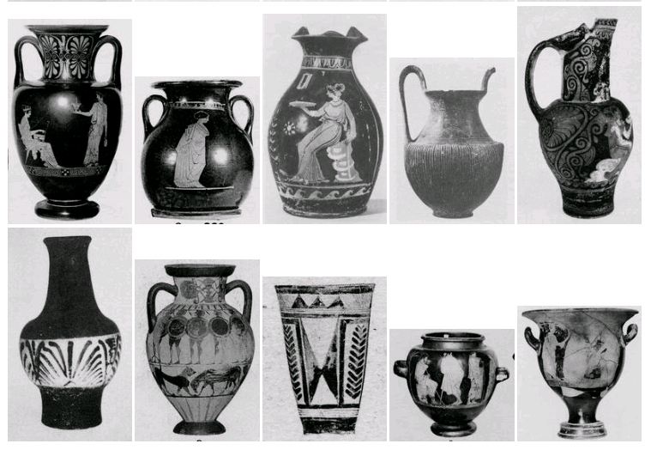
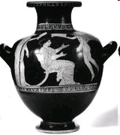
The Objective …
To enable an image archive to be searched on its visual content with the same ease and success as a Google search of the web (text documents).
The Beazley Vase Archive
?
Visually defined query
Currently: 111 thousand images

Slide 45
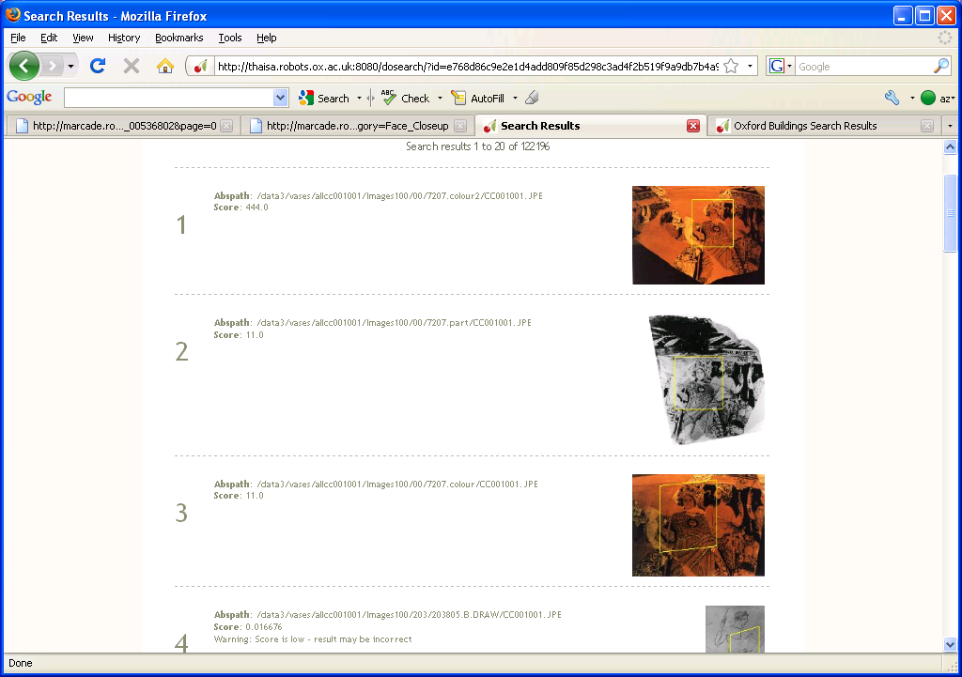
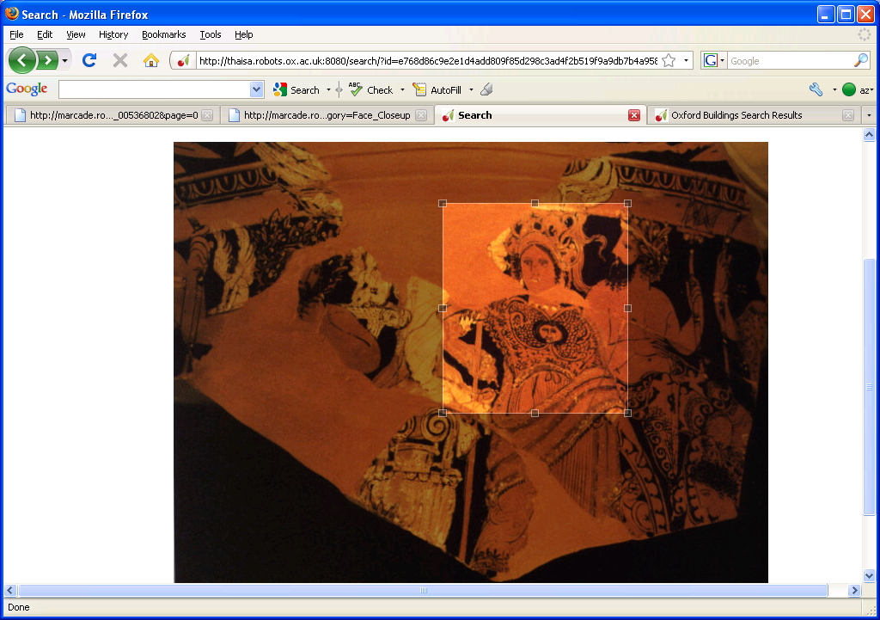
Example
Search results
query
?
Results are:
immediate
unaffected by scale and image rotation (affine transformations)
for exact matches only
Notes:
First demo here

Slide 46
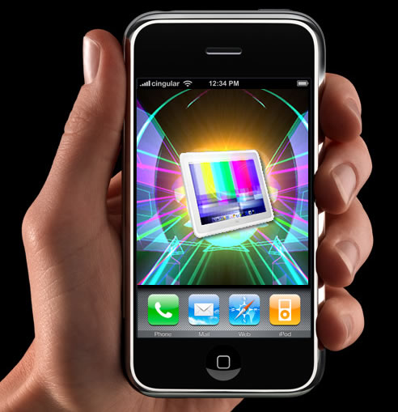
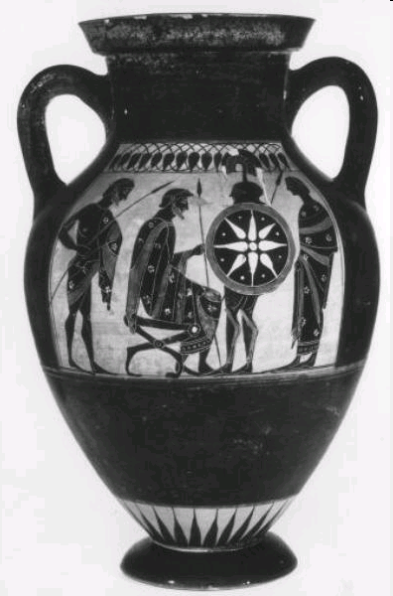
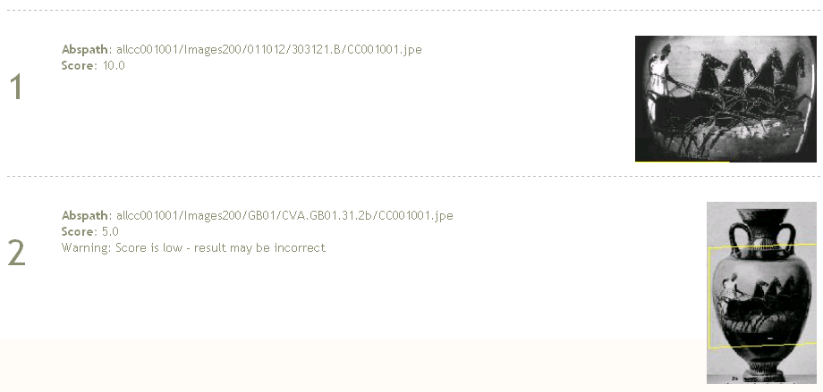
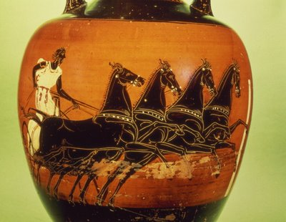
Upload query image from a file or web page or a mobile phone
Matches in the Beazley vase archive
Query from URL
?
http://arthur.robots.ox.ac.uk:8084/
Notes:
http://4.bp.blogspot.com/_uekyjQXowno/SlDXh1RW03I/AAAAAAAADPw/ViCC-JtM1GI/s400/Competitor+in+chariot+race,+Greek+vase,+5th+century+BC_c_Bridgeman+Art+Library+_Getty+Images.jpg

Slide 47
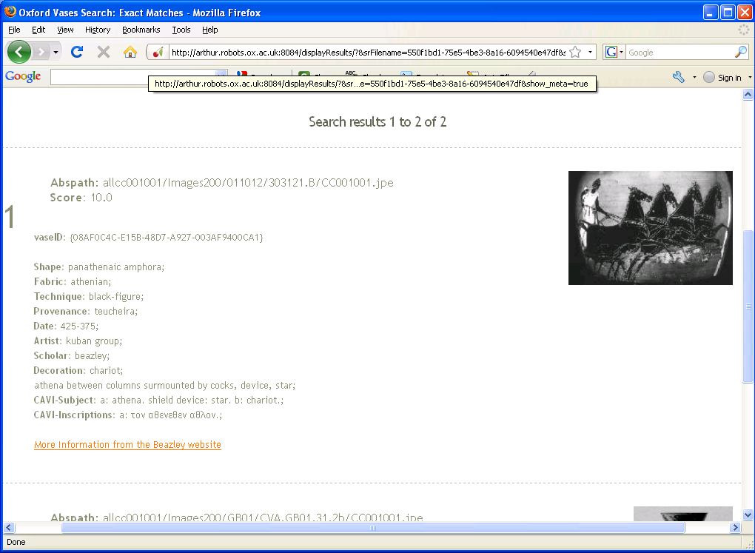
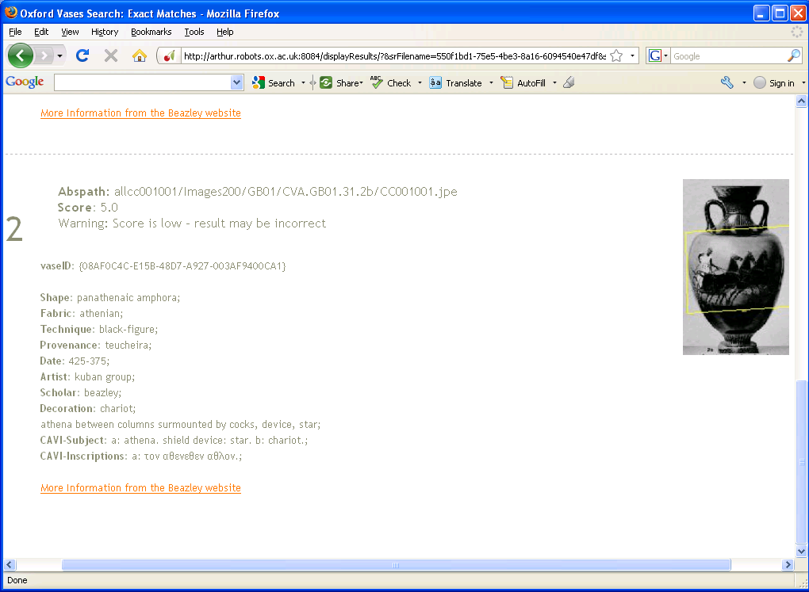
Meta-information for matches
Notes:
A non expert can use an image from the web to find out more information about the vase/decorations/age etc

Slide 48
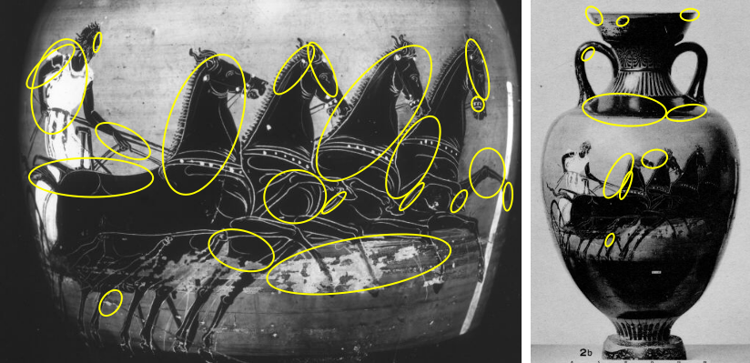
How it works
Representation: bag of (visual) words
Visual words are ‘iconic’ image patches or fragments
Image
Collection of visual words

Slide 49
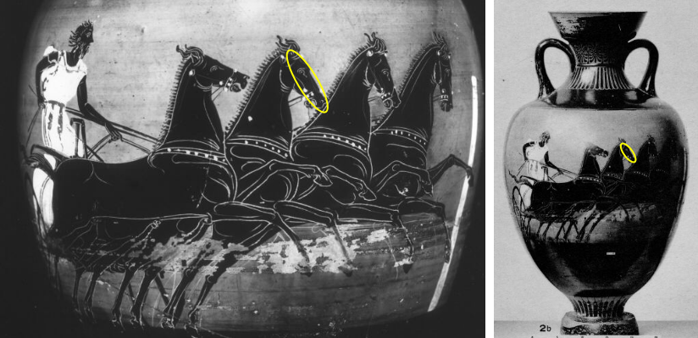
Visual vocabulary unaffected by scale and viewpoint
The same visual word
Notes:
The representation builds in invariance to view point (change in scale, foreshortening)

Slide 50
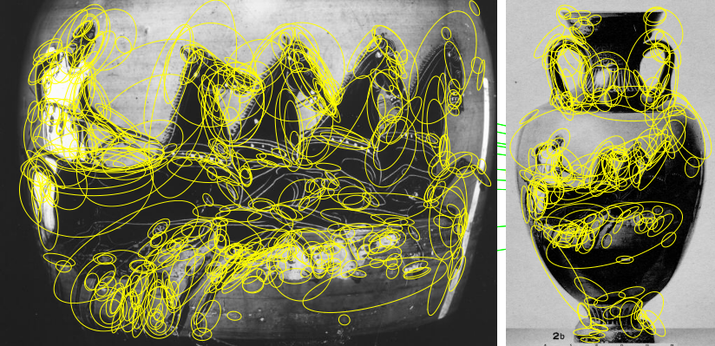
Image representation using visual words
Use efficient Google like search on visual words
Notes:
Each image is represented by 1000s of visual words, and can now use standard Information Retrieval methods – as Google does – for immediate retrieval

Slide 51


The Arachne Classical Sculptures Archive
Retrieve images from the collection using only visual information
?
Visually defined query
Currently: 89 thousand images 21 thousand objects
Notes:
A demo on another dataset within CLAROS. Now sculptures, but exactly the same method.

Slide 52

Example
Search results
query
?

Slide 53


Upload query image from file or URL
Search results
Query from URL
?

Slide 54
Visual search for the archivist
Check visually if an item is already in the archive, or check for duplicate entries
For example, in the Beazley vase archive …
Method:
use each image in turn as a query for retrieval
determine if all the matching vases have the same id
Notes:
With hundreds of thousands of images, it is impossible for the archivist to check everything – such as for duplicate entries. Can also use visual access for in-house data management.

Slide 55

Example:
2 copies with different IDs, and different fabric

Slide 56

Image Classification
previously: search for exact matching vase
now: classify vase by its shape
Visually defined query
“It is an amphora
Data
… and here are similar objects in the archive”
What is this?
Notes:
Now turn from finding a specific vase in an archive from a visual query, to classifying an object from a visual query. For example, labelling a vase by its shape.
You might see an object on the web or in a museum. You could upload it to your mobile phone.
Without using any words to search your image can be sent to the CLAROS site and you will be shown similar pieces.
56

Slide 57


Shape Representation
foreground separation
silhouette representation
original image
vector
X₁
X₂
.
.
.
X_{n}
No representation of patterns or surface markings
100-dimensional “vase shape space”
Notes:
57
Create a ‘description’ of the object in each image – in this case, the shape of the vase, not the decoration or the material.
A number of processing steps were then carried out automatically:
first, the vase is separated from the background
second, the mid-line of the vase is computed, and the shape of the silhouette described in terms of its distance from this line
57

Slide 58




Vase shape space
Notes:
Vases with similar shape will be close together in this space, and those with different shapes further away.
A rounded shape with two handles – for example, the amphora above - is clearly nothing like a more cylindrical shape with one handle hidden from view – a lekythos below.
58

Slide 59

Compute three nearest neighbours for each vase
query
classify shape
all three are neck-amphorae
“judge me by the company I keep”
“vase shape space”
Notes:
This information can then be used to classify the shape of a new vase : if several of the ‘close neighbours’ all agree on the shape, then we can be confident that it does have that shape.
59

Slide 60
Step by step demonstration:
Step 1: upload image
Notes:
As part of Claros we have provided an on-line service to accept images, initially of vases, to be classified.
The greeting web page looks like this, and a user can upload an image starting from the web or from a photo on his own computer.
60

Slide 61
Step by step demonstration:
Step 2: classify shape
Notes:
Here is an example.
The first image is the original upload (the query).
The second shows the separation of the vase foreground from the background - in blue. This separation processing takes a few seconds. The actual search, through 130,000 vase images takes a fraction of a second.
On the right are the images of the three closest vases, and they agree that the shape is 'amphora neck'
Clicking on 'amphora neck' then links to the Claros timeline and a map showing the distribution of where these vases were found.
61

Slide 62

Step by step demonstration:
Step 3: matches in CLAROS
Notes:
62
And a list of similar vases in CLAROS is also provided, all ordered by similarity in shape to the query vase.
Clicking on ANY of these provides information about ts date, location etc. - taken directly from the Beazley Archive pottery databases.
We've illustrated the idea of searching by image with a vase, but we could use the same system for other objects in CLAROS, such as sculpture.
To help Rheinhard with his half million images of classical sculpture Andrew and his team only need to compute a new type of image descriptor.
It sounds simple but the technology is new and challenging.
And why are we doing this? After all. I could have told you it was an amphora –neck in a fraction of a second!
We are doing this primarily to broaden access: when there is no text in the search there are no language barriers. Anyone can search this way free and also be wholly from the constraints of the terminology that classical archaeologists have generated for centuries.
Looking farther ahead I see the potential for a global registry of antiquities that will engage with the public.
When a traveller, an excavator, a collector or a curator in a museum store sees an object and does not know what it is, he can upload it to CLAROS. An image recognition system can sort the sculpture from the pottery, the gems from the bronzes, and send each type of object to the centre where it is studied – for example, the sculpture to Cologne, the pottery and gems to Oxford. We identify the object, give it a unique record number and upload it to CLAROS where every one can see it.
This will greatly stimulate academic research.
62

Slide 63



Future Developments
Short term (this year): 3D retrieval
Medium term: classification of decorations
Longer term: predict artist/age
“Herakles and the lion”

Slide 64
Notes:
old and new walls of Instanbul, page of CVA, map of distribution of Jews etc
64

